Slide 1




Slide 2

TEST TIME ON MAXIMUM PRODUCT SUBARRAY
URL:https://forms.gle/4LD4LutpGGuCE5zR8
QR CODE:

Slide 3

MAXIMUM SUM OF HOURGLASS IN MATRIX

Slide 4
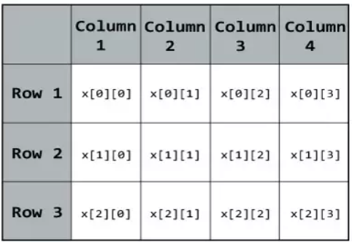
Introduction:
In this problem, we have a matrix i.e. two-dimensional (2D) array.
Example:
We have to find the maximum sum of the hourglass value of a matrix.

Slide 5

Introduction:
Hourglass:
The hourglass concept in the algorithm comes from the device which is used to measure the passage of time. The device is called sandglass.

Slide 6
Introduction:
Hourglass format:
Hourglass is a 7-element shape made in the matrix in the following form:
X X X
X
X X X

Slide 7
Important note:
The number of rows or columns of hourglass must be equal to 3 i.e. three index values at the top, one in the middle, and three at the bottom
The total number of hourglasses in a matrix is equal to (R-2) * (C-2), where R refers to the number of Rows and C refers to the number of Columns.
TOP
MIDDLE
BOTTOM

Slide 8
Example 1:
Let Rows = 5 Columns = 5
Matrix is: 1 2 4 5 6 7 5 2 3 6 0 0 0 0 0 7 5 1 3 5 0 0 0 0 0
All the possible hourglass in this Matrix are:
1 2 4 2 4 5 4 5 6 5 2 3 0 0 0 0 0 0 0 0 0
7 5 2 5 2 3 2 3 6 0 0 0 7 5 1 5 1 3 1 3 5
0 0 0 0 0 0 0 0 0 5 1 3 0 0 0 0 0 0 0 0 0
Maximum sum of hourglass is 27

Slide 9
Hourglass can be created using the following indexes:-
matrix[i][j] matrix[i][j+1] matrix[i][j+2]
matrix[i+1][j+1]
matrix[i+2][j] matrix[i+2][j+1] matrix[i+2][j+2]
We will find the sum of all these elements of the array from [0][0] to [R-2][C-2] starting points. And the find the maxSum for all these hourglasses created from array elements.
Example 2:
Consider the
Rows = 4 Columns = 4
matrix:-
2 4 0 0
0 1 1 0
4 2 1 0
0 3 0 1

Slide 10
The hourglasses are :
2 4 0 0 1 1
1 2
4 2 1 0 3 0
4 0 0 1 1 0
1 1
2 1 0 3 0 1
Maximum sum of hourglass is 14

Slide 11
import java.io.*; class Main { static int row = 5; static int col = 5; static int findMaxSum(int [][]mat) {if (row < 3 || col < 3){ System.out.println("Not possible to give"); System.exit(0); } int max_sum = Integer.MIN_VALUE; for (int i = 0; i < row - 2; i++){ for (int j = 0; j < col - 2; j++){ int sum = (mat[i][j] + mat[i][j + 1] + mat[i][j + 2]) + (mat[i + 1][j + 1]) + (mat[i + 2][j] + mat[i + 2][j + 1] + mat[i + 2][j + 2]); max_sum = Math.max(max_sum, sum); }} | return max_sum; } static public void main (String[] args) { int [][]mat = {{1, 2, 3, 0, 0}, {0, 0, 0, 0, 0}, {2, 1, 4, 0, 0}, {0, 0, 0, 0, 0}, {1, 1, 0, 1, 0}}; int res = findMaxSum(mat); System.out.println("Maximum sum of hour glass = "+ res); } }
Notes:
Maximum sum of hour glass = 13

Slide 12
Time and space complexity
Time complexity: O(R*C)
where R is the number of Rows,C is the number of columns
space complexity: O(1)
No extra data structure is used for computation
Notes:
Maximum sum of hour glass = 13

Slide 13
Interview questions
What is an hourglass pattern in a 2D array?
An hourglass pattern in a 2D array is a subset of values that form the shape of an hourglass. It consists of seven elements arranged in the following pattern:
a b c
d
e f g

Slide 14
Interview questions
How do you find the maximum sum of an hourglass pattern in a 2D array?
To find the maximum sum of an hourglass pattern, we iterate over the 2D array, considering each possible hourglass pattern. We calculate the sum of the elements in each hourglass and keep track of the maximum sum encountered.

Slide 15
Interview questions
How do you handle cases where the maximum sum of the hourglass pattern is negative?
If the maximum sum is negative, it means that all hourglass patterns in the array have negative sums. In this case, we can conclude that the maximum sum of any hourglass pattern is 0.

Slide 16

https://learn.codemithra.com

Slide 17




THANK YOU
+91 78150 95095
codemithra@ethnus.com
www.codemithra.com

